Slide 1

Introduction to Databases
CE3101 - Databases

Slide 2
Disclaimer / Descargo de responsabilidad
This presentation was prepared with the guide material used by the professor during classes. It has been modified to be used as a summary for students. It is not a final version, so it may still require some adjustments. For evaluation aspects, this presentation is only a guide, so the student should delve with the assigned reading material and what has been discussed in class.
Esta presentación fue elaborada con el material de guía usado por el profesor durante las clases. El mismo ha sido modificado para ser utilizado como resumen para los estudiantes. No es una versión final, por lo que la misma podría requerir todavía hacer algunos ajustes. Para aspectos de evaluación esta presentación es solo una guía, por lo que el estudiante debe profundizar con el material de lectura asignado y lo discutido en clases para aspectos de evaluación.

Slide 3
Pregunta inicial
¿Saben cómo se hace el café más caro del mundo?

Slide 4
Concepts
Database refers to a set of related data and the way it is organized.
Random ordering?

Slide 5
Concepts
Database refers to a set of related data and the way it is organized.
Random ordering?
Random structure?

Slide 6
Concepts
Database refers to a set of related data and the way it is organized.
Access to these data is usually provided by a "database management system" (DBMS) consisting of an integrated set of computer software that allows users to interact with one or more databases and provides access to all of the data contained in the database. Examples?

Slide 7
Concepts
The database systems are an essential component of life in modern society: most of us encounter several activities every day that involve some interaction with a database.

Slide 8

Concepts
The database systems are an essential component of life in modern society: most of us encounter several activities every day that involve some interaction with a database.
EXAMPLES
Bank to deposit or withdraw funds.

Slide 9

Concepts
The database systems are an essential component of life in modern society: most of us encounter several activities every day that involve some interaction with a database.
EXAMPLES
Bank to deposit or withdraw funds.
Hotel or airline reservation.

Slide 10

Concepts
The database systems are an essential component of life in modern society: most of us encounter several activities every day that involve some interaction with a database.
EXAMPLES
Bank to deposit or withdraw funds.
Hotel or airline reservation.
Access a computerized library catalog.

Slide 11

Concepts
The database systems are an essential component of life in modern society: most of us encounter several activities every day that involve some interaction with a database.
EXAMPLES
Bank to deposit or withdraw funds.
Hotel or airline reservation.
Access a computerized library catalog.
Purchase something online.

Slide 12
Concepts
The database systems are an essential component of life in modern society: most of us encounter several activities every day that involve some interaction with a database.
All these activities involve someone or some computer program accessing database.
EXAMPLES
Bank to deposit or withdraw funds.
Hotel or airline reservation.
Access a computerized library catalog.
Purchase something online.

Slide 13
Concepts
A database represents some aspect of the real world, sometimes called the miniworld or the universe of discourse (UoD). Changes to the miniworld are reflected in the database.
A database is a logically coherent collection of data with some inherent meaning. A random assortment of data cannot correctly be referred to as a database.
A database is designed, built, and populated with data for a specific purpose. It has an intended group of users and some preconceived applications in which these users are interested.

Slide 14
Concepts
Database refers to a set of related data and the way it is organized.
DBMS (Database Management System) refers to a set of computer software that allows user to interact with databases and provide access to all of the data contained in the database. Examples?
Miniworld or Universe of Discourse (UoD) refers to aspects of real world that are represented by a database.

Slide 15
Concepts
Database refers to a set of related data and the way it is organized.
DBMS (Database Management System) refers to a set of computer software that allows user to interact with databases and provide access to all of the data contained in the database. Examples?
Miniworld or Universe of Discourse (UoD) refers to aspects of real world that are represented by a database.
SABD in spanish

Slide 16



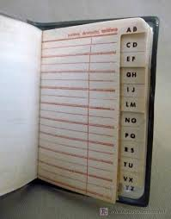

Concepts
BEFORE
AFTER

Slide 17
Concepts
Complex & Size
BEFORE
AFTER

Slide 18




Concepts
Amazon
It contains data for over 20 million books, CDs, videos, DVDs, games, electronics, apparel and other items.
The database occupies over 2 terabytes (a terabyte is 1012 bytes worth of storage) and is stored on 200 different computers (called servers).
About 15 million visitors access Amazon.com each day and use the database to make purchases.

Slide 19
Concepts
A database management system (DBMS – SABD)
Is a collection of programs that enables users to create and maintain a database.
The DBMS is a general-purpose software system that facilitates the processes of defining, constructing, manipulating, and sharing databases among various users and applications.

Slide 20
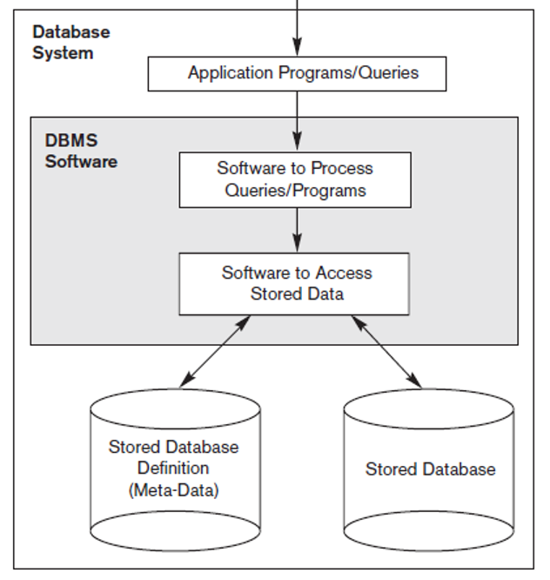
Concepts

Slide 21
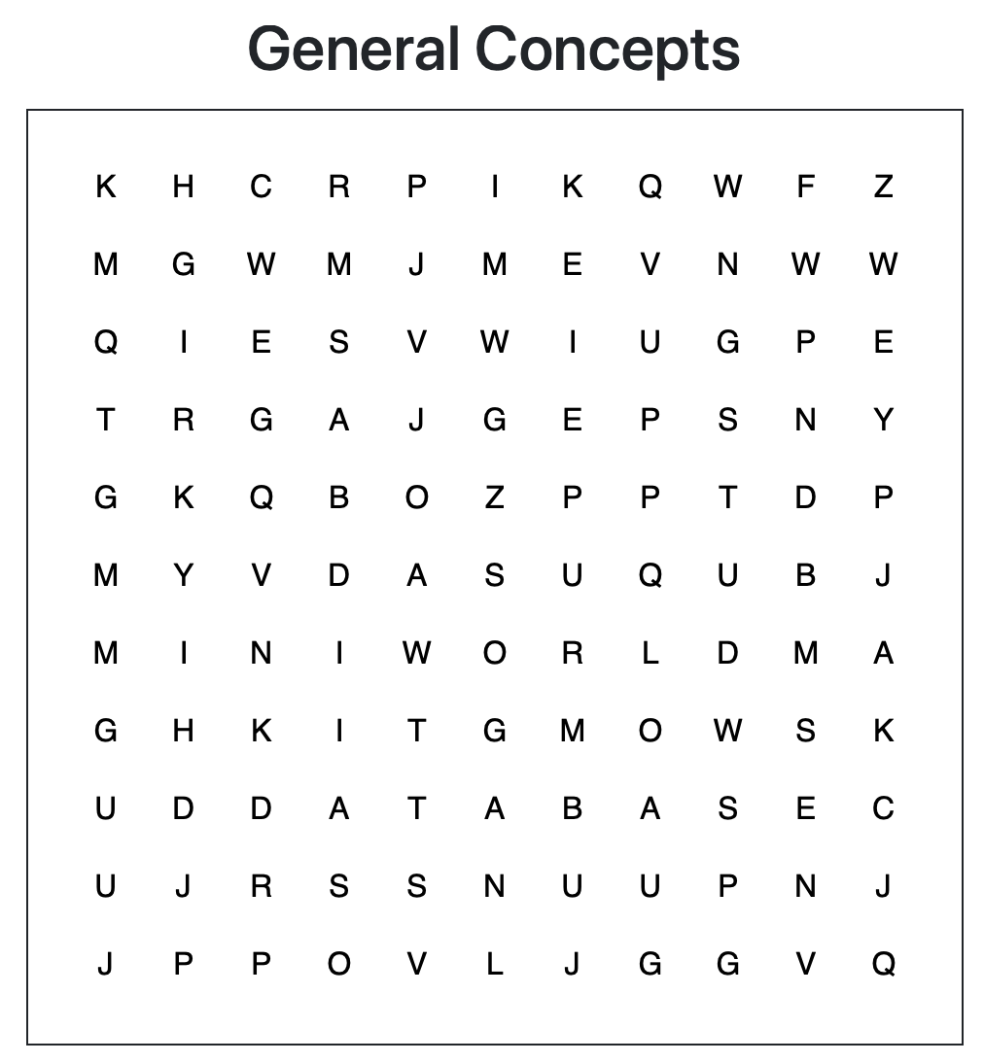
Concepts

Slide 22
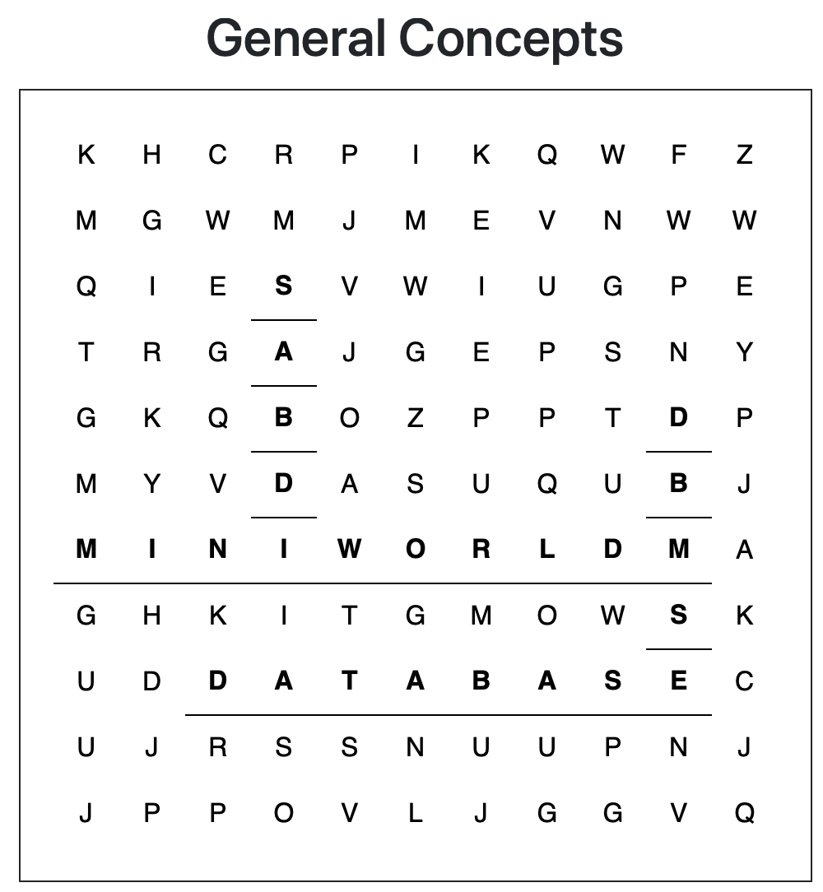
Concepts

Slide 23
Characteristics of the Database Approach
Self-Describing Nature of a Database System (Meta-Data)
The database system contains not only the database itself but also a complete definition or description of the database structure and constraints.
Insulation between Programs and Data, and Data Abstraction
Support of Multiple Views of the Data
Sharing of Data and Multiuser Transaction Processing

Slide 24
Actors
DATABASE ADMINISTRATOR (DBA)
Primary resource: the database itself.
Secondary resource is the DBMS and related software.
Administering these resources is the responsibility of the database administrator (DBA).
Responsible for authorizing access to the database, coordinating and monitoring its use, and acquiring software and hardware resources as needed

Slide 25
Actors
In large organizations, the DBA is assisted by a staff that carries out these functions.
DATABASE ADMINISTRATOR (DBA)
Primary resource: the database itself.
Secondary resource is the DBMS and related software.
Administering these resources is the responsibility of the database administrator (DBA).
Responsible for authorizing access to the database, coordinating and monitoring its use, and acquiring software and hardware resources as needed

Slide 26
Actors
DATABASE ADMINISTRATOR (DBA)
DATABASE DESIGNERS
Primary resource: the database itself.
Secondary resource is the DBMS and related software.
Administering these resources is the responsibility of the database administrator (DBA).
Responsible for authorizing access to the database, coordinating and monitoring its use, and acquiring software and hardware resources as needed
Are responsible for identifying the data to be stored in the database and for choosing appropriate structures to represent and store this data.

Slide 27
Actors
END USERS
End users are the people whose jobs require access to the database for querying, updating and generating reports.
The database primarily exists for this use.

Slide 28
Actors
END USERS
CASUAL END USERS
End users are the people whose jobs require access to the database for querying, updating and generating reports.
The database primarily exists for this use.
Occasionally access the database, but they may need different information each time.

Slide 29
Actors
END USERS
CASUAL END USERS
End users are the people whose jobs require access to the database for querying, updating and generating reports.
The database primarily exists for this use.
Occasionally access the database, but they may need different information each time.
PARAMETRIC END USERS
Their main job function revolves around constantly querying and updating the database, using standard types of queries and updates that have been carefully programmed and tested.

Slide 30
Actors
END USERS
SOPHISTICATED END USERS
End users are the people whose jobs require access to the database for querying, updating and generating reports.
The database primarily exists for this use.
Include engineers, scientists, business analysts.
Familiarize themselves with the facilities of the DBMS in order to implement their own applications to meet their complex requirements.

Slide 31

Respuesta a la pregunta inicial

Slide 32
Actors
END USERS
SOPHISTICATED END USERS
End users are the people whose jobs require access to the database for querying, updating and generating reports.
The database primarily exists for this use.
Include engineers, scientists, business analysts.
Familiarize themselves with the facilities of the DBMS in order to implement their own applications to meet their complex requirements.
STANDALONE USERS
Maintain personal databases by using ready-made program packages that provide easy-to-use menu-based or graphics-based interfaces. An example is the user of a tax package that stores a variety of personal financial data for tax purposes.

Slide 33
Advantages of using the DBMS Approach
Controlling redundancy.
Restricting unauthorized access.
Providing storage structures and search technique for efficient query processing.
Providing backup and recovery.

Slide 34
Advantages of using the DBMS Approach
Controlling redundancy.
Restricting unauthorized access.
Providing storage structures and search technique for efficient query processing.
Providing backup and recovery.
Enforcing integrity constraints.
Providing multiple user interfaces.
Providing persistent storage for program objects.

Slide 35
Data Models, Schemas and Instances
Refers to the suppression of details of data organization and storage, and the highlighting of the essential features for an improved understanding of data.
Data Abstraction
Collection of concepts that can be used to describe the structure of a database.
Provides the necessary means to achieve this abstraction.
Data Model

Slide 36
Data Models, Schemas and Instances
(Categories of Data Models)
High-level (Conceptual). Provide concepts that are close to the way many users perceive data.
Low-level (Physical). Provide concepts that describe the details of how data is stored on the computer storage media.
Representational. Which provide concepts that may be easily understood by end users but that are not too far removed from the way data is organized in computer storage.

Slide 37
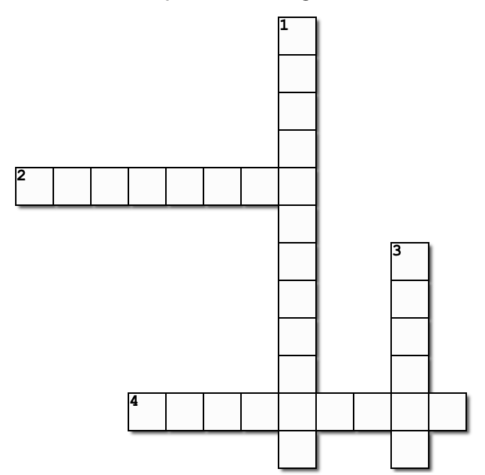
Data Models, Schemas and Instances
High-level Data Models
Vertical
Represents an association among the entities.
Represents a real-world object or concept.
Horizontal
The data in the database at a particular moment.
Represents some property of interest that further describes an entity.

Slide 38
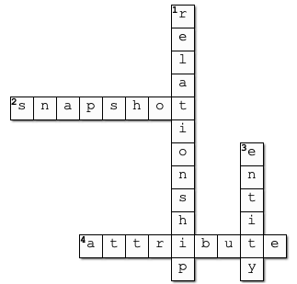
Data Models, Schemas and Instances
High-level Data Models
Vertical
Represents an association among the entities.
Represents a real-world object or concept.
Horizontal
The data in the database at a particular moment.
Represents some property of interest that further describes an entity.

Slide 39
Data Models, Schemas and Instances
High-level Data Models
Vertical
Represents an association among the entities.
Represents a real-world object or concept.
Horizontal
The data in the database at a particular moment.
Represents some property of interest that further describes an entity.
Empty state
Initial state
Valid state

Slide 40
Data Models, Schemas and Instances
Database Schema. Is the description of the database. Which is specified during database design and is not expected to change frequently.
Schema Diagram. A displayed schema. Displays only some aspects of a schema, such as the name of record type and data items, and some types of constraints.

Slide 41
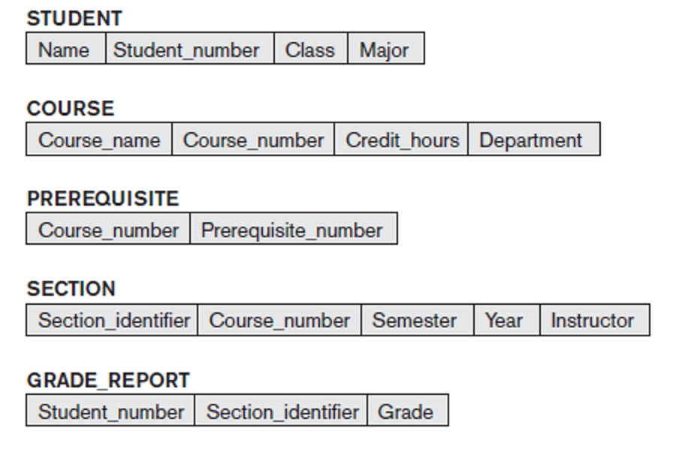
Data Models, Schemas and Instances
Schema Diagram

Slide 42
Schemas, Instances and Database State
Database state or snapshot
The data in the database at a particular moment.
Empty state: its database schema only.
Initial state: when the database is first populated or loaded with the initial data.
Valid state: is a state that satisfies the structure and constraints specified in the schema.

Slide 43
Data Models, Schemas and Instances
DDL (Data Definition Language). Used by DBA and designers to define both schemas.
SDL (Storage Definition Language). Used to specify the internal schema.
VDL (View Definition Language). Used to specify user views and their mappings to the conceptual schema.
DML (Data Manipulation Language (DML). Used to manipulate the database. Typical manipulations include: retrieval, insertion, deletion and modification of the data.

Slide 44
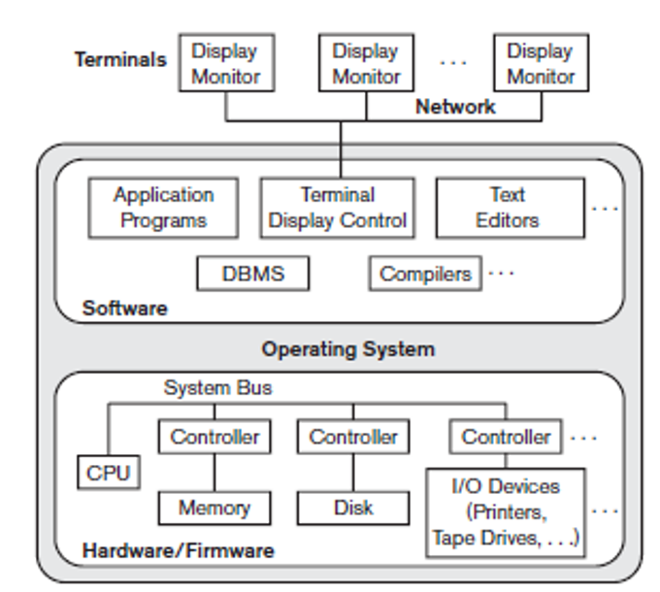
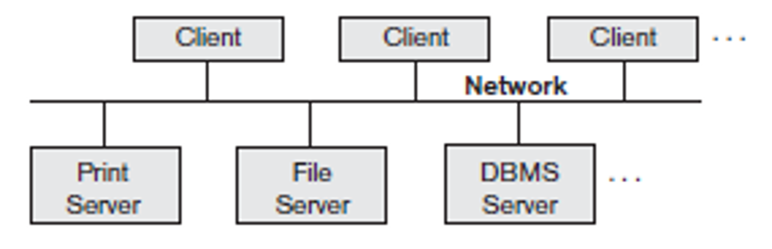
Centralized and Client/Server Architectures for DBMSs
Centralized DBMs Architecture
Basic Client/Server Architectures

Slide 45
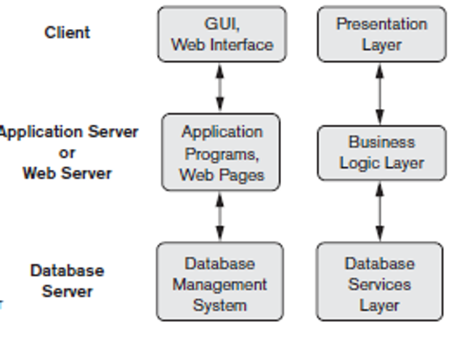
Centralized and Client/Server Architectures for DBMSs
Centralized DBMs Architecture
Basic Client/Server Architectures
Three-Tier and n-Tier Architecture for Web Applications

Slide 46
Classification of Database Management Systems
DATA MODEL
NUMBER OF USERS
NUMBER OF SITIES
Relational
Object
Hierarchical
Network
Single-user Systems
Multiuser Systems
Centralized
Distributed

Slide 47
Introduction to Databases
CE3101 - Databases

